Slide 1



My Time at PNC
CS 1900 Capstone Presentation
Ayden Kauffman

Slide 2
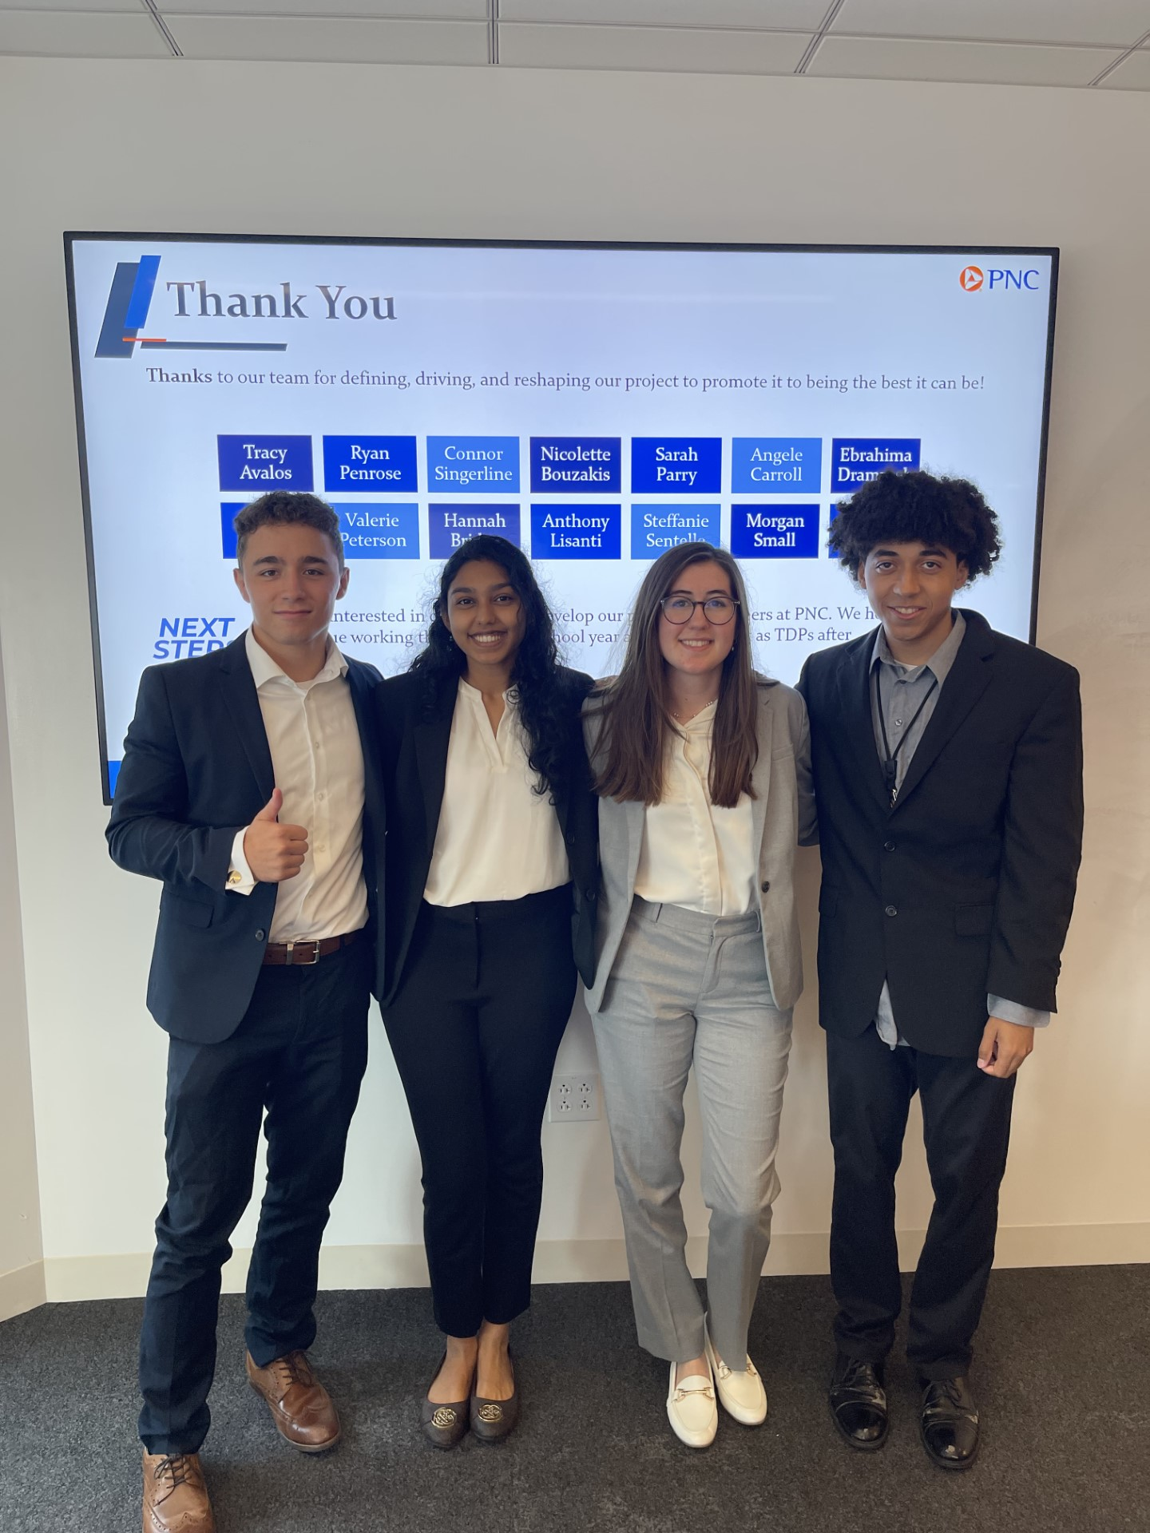
Internship Format
Enterprise Technology and Security Advanced Analytics
Original Primary team
Scrum (Kanban) Team
Daily standups & Weekly one-on-ones
One overarching project
Team with 3 other interns
In the office 5 days a week
Enterprise Technology and Security DevOps PAC
Policy as Code
Scrum (Agile) Team
Daily Standups

Slide 3

ET&S Advanced Analytics Responsibilities
Hot 100 Dashboard
Top 100 metrics leverage by PNC’s CTO Debbie Guild
PowerBI Dashboard
General daily bug fixes and metric reworks
OKR (Objective Key Results) Reporting Process Rework
Original process done in Tableau & Excel with no automation
Build out similar to the Hot 100 Dashboard
Complete Ownership and full responsibility
~700 OKRs

Slide 4
Tools Used
Sharepoint
Python
PowerBI
Power Automate
Power
Apps

Slide 5
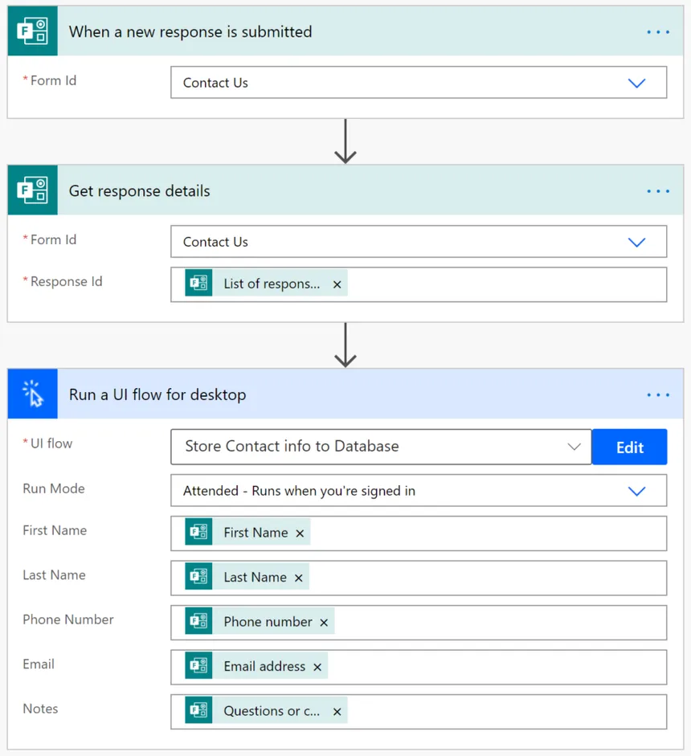
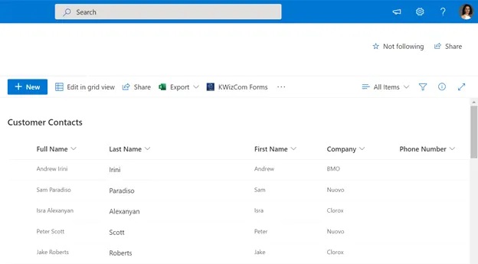
What did I contribute
SQL for querying the data that was being used in tableau
Handled most of the data cleansing in Python before Sharepoint & PowerBI
Data was generally unstructured
Built out the logic for the dashboard in PowerBi using Python & DAX
Multiple Power Automate workflows to automate the process of sending emails to segment leads and data providers
Input access & deadline reminders

Slide 6
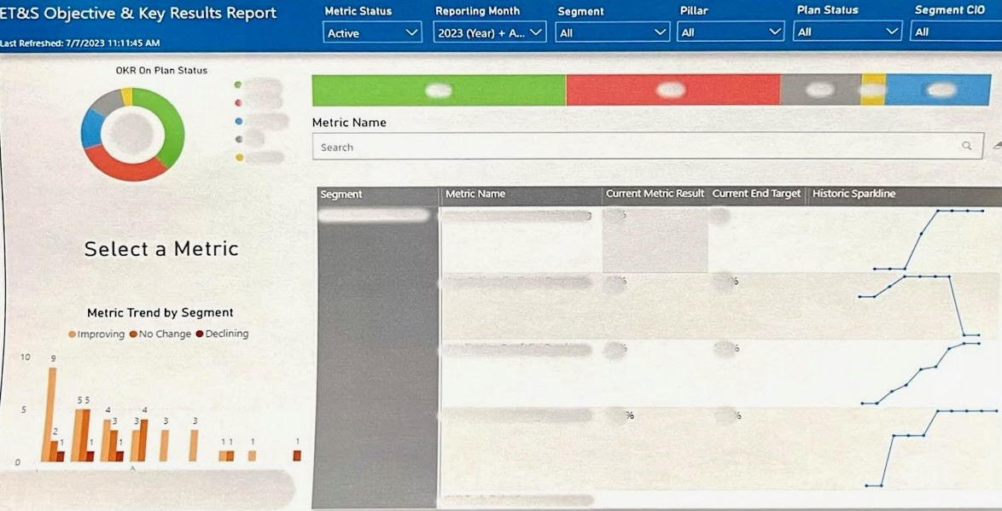
Production Dashboard

Slide 7


Business Value Brought
145 Hours per year
$10,500 per year

Slide 8
Advanced Analytics Centralized Application
Build an app using PowerApps
Hosted the dashboards, intake forms, and metric directory for leadership to view
Daily UI/UX review

Slide 9


DevOps PAC Team Tools Used

Slide 10
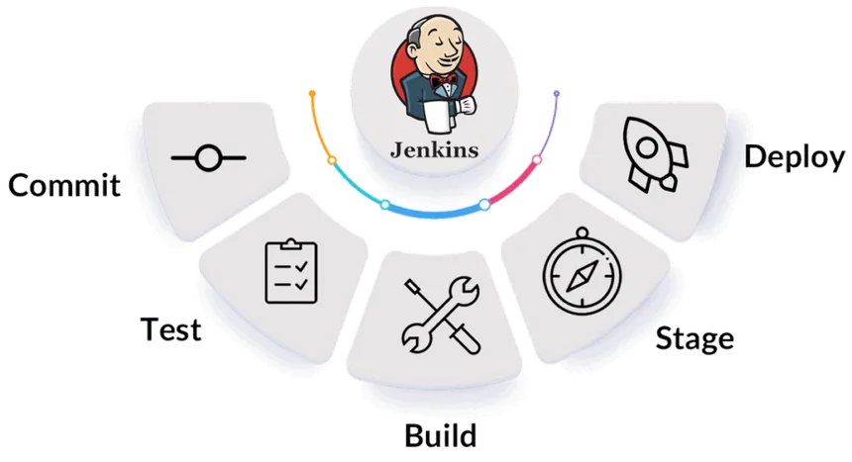
Main Responsibilities on PaC
Overseeing the CI/CD pipeline for qualifying size software projects
Assisted my mentor with consulting teams on newly developed software projects that fall within the mnemonics policy at PNC
Mnemonics have certain rules related to change management and containerization policies
Establishing a Jenkins pipeline for the software
Help build Dashboard Analytics

Slide 11
Questions?

